Slide 1
Session 4 – La musique! - 2nd lesson
Please follow the powerpoint and self-mark any activities in red font where I have provided the answers. Please can you type up all your work to the word document attached “2- Session 4 - Worksheet - musique 2nd lesson“ or complete exercises on a piece of paper.

Slide 2
Starter: Translate into English (use google translate or wordreference for help if needed)
1. 2. 3. 4.
5. 6. 7. 8. 9.

Slide 3
Starter: Translate into English (use google translate or wordreference for help if needed)
Answers
this kind of music doesn't attract/interest me
I can't live without music
electronic music makes me want to dance
Music reminds me of something other than everyday life or trouble
Music makes me smile and makes me happy
Music cheers me up
The rhythm is catchy
the lyrics tell me something
the lyrics make me think of ...
Mark in red pen/font
1. 2. 3. 4.
5. 6. 7. 8. 9.

Slide 4
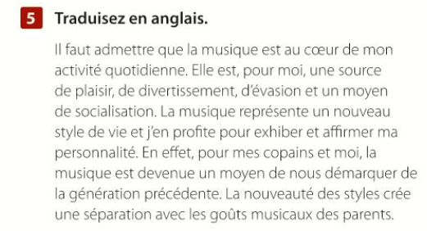
Extension p. 91 ex. 5: Translate into English….

Slide 5
Extension p. 91 ex. 5: Translate into English….
Mark in red pen/font
Suggested answer from AQA
I must admit that music is at the heart of my daily activity. It is, for me, a source of pleasure, entertainment, escape and a means of socialising. Music represents a new way of living and I make the most of it to show and affirm my personality. In fact, for my friends and me, music has become a way to set ourselves apart from the previous generation. The originality of styles makes a break from the musical tastes of our parents.

Slide 6
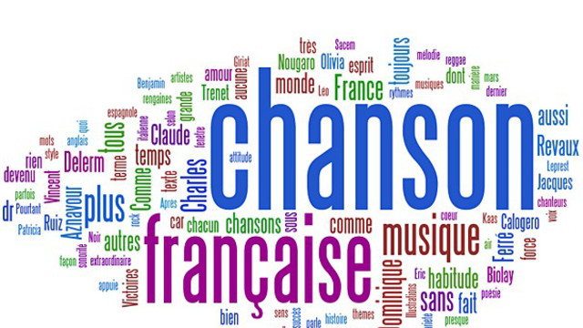
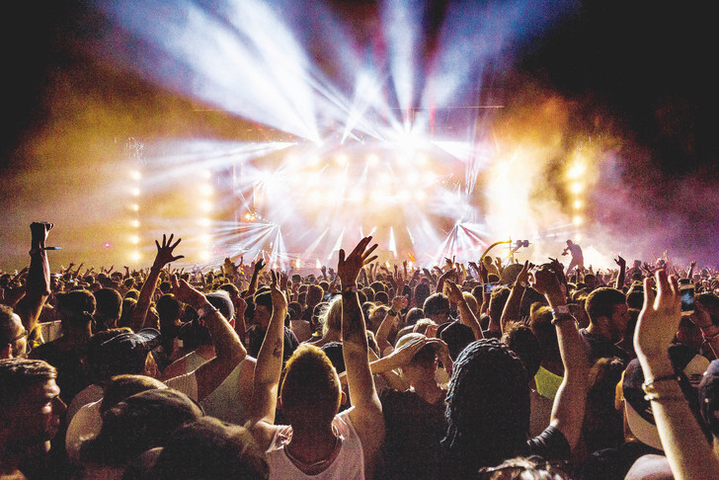
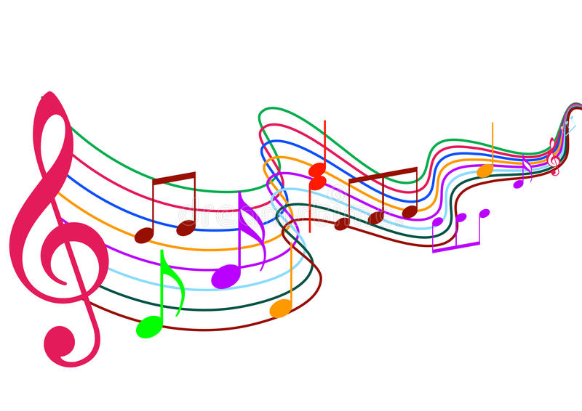
Les festivals de musique dans les pays francophones!

Slide 7
Vieilles charrues (Carhaix, dans l’oeust de Bretagne, France)
https://www.youtube.com/watch?v=vvn4TXq93kc
Watch 30 seconds -> 1:10-1:40
1:00 -> 1:30

Slide 8
Hellfest (Nantes, France)
Watch 30 seconds -> 1:10-1:40 https://www.youtube.com/watch?v=huTBYFYTMec

Slide 9
Canada - Festival d'été de Québec (FEQ)
Watch 30 seconds -> 0:10-0:38
https://www.youtube.com/watch?v=3NOCm423M24

Slide 10
Le festival du sahel (Le desert de Lampoul, Sénégal, Afrique)
(Watch 30 seconds: 0:00 -> 0:30) https://www.youtube.com/watch?v=dk9nswVjkec

Slide 11
Extension: News video + Listening comprehension https://www.youtube.com/watch?v=FnWAMCY8uzc
1. Où est le festival exactement et quelle est la distance de Dakar? ______________________________________________________________
2. Quelle est l’importance de Dakar? ______________________________________________________________
3. À quelle date le festival a-t-il commencé et combien de temps a-t-il duré? ______________________________________________________________
4. Qui est le «bob dylan» sénégalais? ______________________________________________________________
5. Combien de personnes sont allées au festival cette année? ______________________________________________________________
6. Quel est le message du festival mentionné par l'homme? ______________________________________________________________
7. Que s'est-il passé l'année dernière? ______________________________________________________________

Slide 12
Extension: News video + Listening comprehension https://www.youtube.com/watch?v=FnWAMCY8uzc
Où est le festival exactement et quelle est la distance de Dakar?
Le désert de Lompoul. 555 km de Dakar.
2. Quelle est l’importance de Dakar?
C’est la capitale sénégalaise.
3. À quelle date le festival a-t-il commencé et combien de temps a-t-il duré?
23 novembre, un week-end.
4. Qui est le «bob dylan» sénégalais?
Ismaël LO
5. Combien de personnes sont allées au festival cette année?
Près de 1000
6. Quel est le message du festival mentionné par l'homme?
Un festival de paix ainsi qu'une occasion de partager leur musique et leur culture.
7. Que s'est-il passé l'année dernière?
Il a été annulé faute de sponsors.
Mark in red pen/font

Slide 13
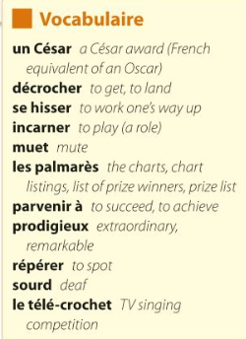
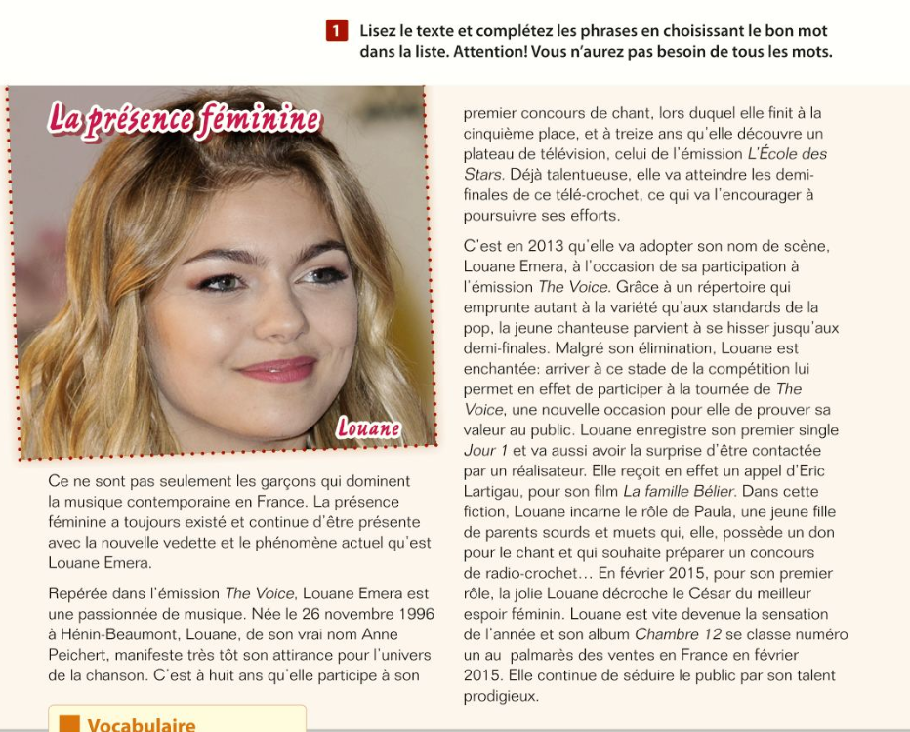
Read out loud and look up 5/10 words on google translate or wordreference

Slide 14
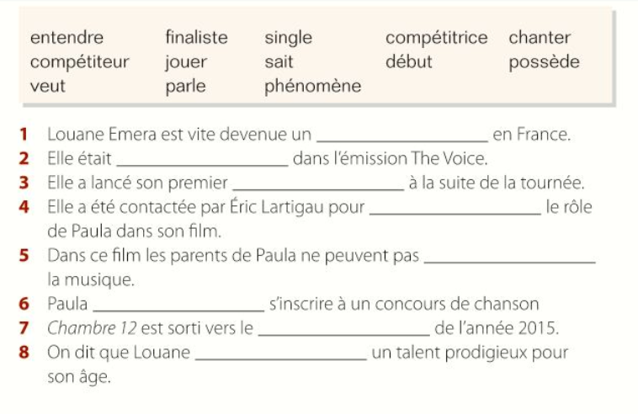
p. 92 ex.1 – Reading comprehension: fill in the gaps

Slide 15
Mark in red pen/font
Answers
1 phénomène
2 compétitrice
3 single
4 jouer
5 entendre
6 veut
7 début
8 possède

Slide 16
p. 93 ex.2a – Listening comprehension: listen to the report and write down the French equivalents for the words (qs 1-12)

Slide 17
Answers
1 au-delà des frontières nationales de l’Hexagone
2 la scène musicale francophone
3 une réussite primordiale
4 afin de produire
5 fortement inspiré(e) par
6 n’oublions pas
7 particulièrement populaire
8 parmi les jeunes
9 ainsi que
10 la musique préférée
11 proche de la musique européenne
12 un mélange intéressant
Mark in red pen/font

Slide 18
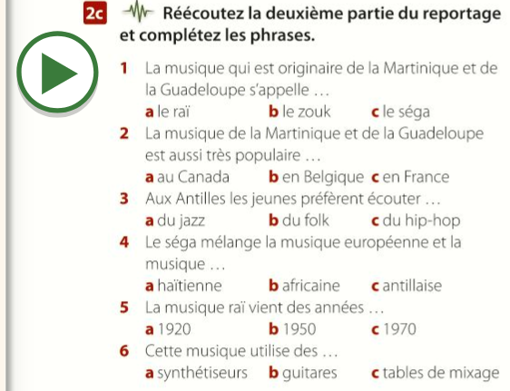
p. 93 ex.2c – Listening comprehension: listen to the report again and choose the correct end (a-c) of the sentences (1-6).

Slide 19
Mark in red pen/font
Answers
1 b
2 a
3 c
4 b
5 a
6 a

Slide 20
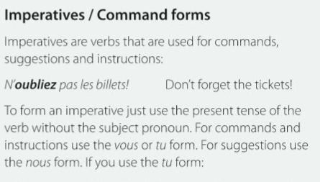
Nous form (suggestions): e.g. Parlons de l’impératif = Let’s speak about the imperative
Can you have a guess as to how might we translate this?

Slide 21
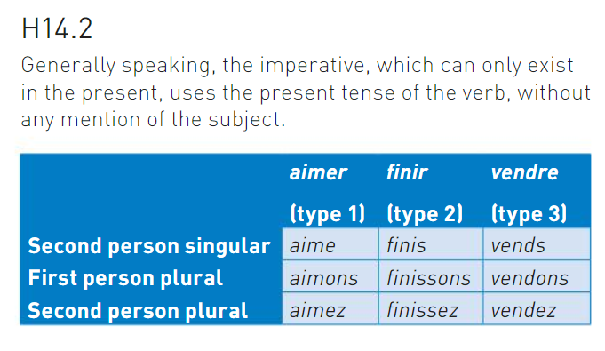
Point de grammaire (Grammar point) L’impératif! The imperative!
Révision (revision)
La réponse:
Same endings except for –er verbs second person singular : no –s ending in the imperative e.g. tu consultes – consulte !; tu oublies – oublie !
(tu – you sg.) Same as “tu” form of present tense (minus the last “s”)!
(nous – let’s…) Same as “nous” form of present tense!
(vous – you pl.) Same as “vous” form of present tense!
The imperative does NOT include the subject – e.g. Listen (you pl.)! (vous) Écoutez!

Slide 22
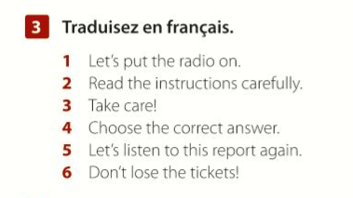
p. 93 ex. 3 - Translation

Slide 23
Mark in red pen/font
Answers
1 Allumons / Mettons la radio.
2 Lisez / Lis attentivement les instructions.
3 Faites / Fais attention! / Prenez / Prends garde!
4 Choisissez / Choisis la bonne réponse.
5 Réécoutons ce reportage.
6 Ne perdez pas / Ne perds pas les billets!

Slide 24
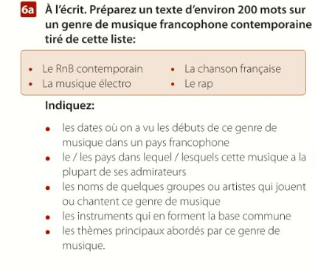
Prepare a spoken presentation
Research a style of music (it doesn’t have to be limited to the list below). Make sure you do a spoken presentation in French on the emergence of this music from a French speaking perspective (a French speaking country). Complete the presentation by speaking out loud or with a partner.
Préparez une presentation orale
or any other styles
You could talk about (however please don’t be restricted by these points): - the date when these genres emerged in a French speaking country
The country where this genre of music is the most popular
The norms of some groups/artists who play/sing this type of music
The main instruments used in this music genre
The principle themes/ideas covered by this type of music.

Slide 25
Enrichment:
Keep practising the imperative tense: https://www.languagesonline.org.uk/French/Grammar/Imperative/Index.htm
2) Listen to this podcast about how to learn French through listening to music! This podcast is designed for French learners. The transcript (click on “lire la transcription”) and the audio are on the website: https://innerfrench.com/blog/2019/02/05/30-apprendre-francais-musique/
3) Listen to the French radio and music! : https://ecouterradioenligne.com/

